Slide 1
Live Count
Post-Larva Prawn Seed Detection System

Slide 2
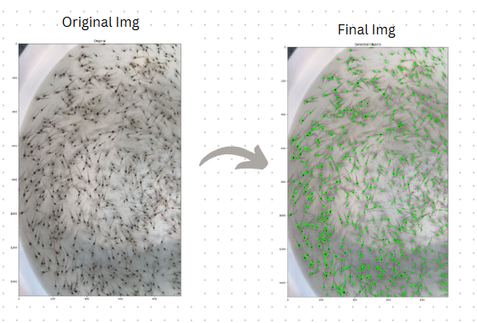
Challenges in Post-Larva Seed Counting
Manual Counting Limitations:
Time-consuming and labor-intensive.
High chances of human error due to the tiny size of post-larva (PL) seeds.
Difficulty in distinguishing seeds from debris or uneven backgrounds.
Industry Need:
Accurate PL seed counts are critical for hatchery operations and aquaculture success.
Lack of scalable, automated solutions tailored specifically for post-larva seeds.

Slide 3
Automated Detection for Post-Larva Seeds
Introducing a specialized image processing tool designed for PL prawn seeds.
01
02
03
High accuracy in detecting and counting PL seeds
Scalability for hatcheries and aquaculture farms.
Ease of use with customizable parameters.

Slide 4
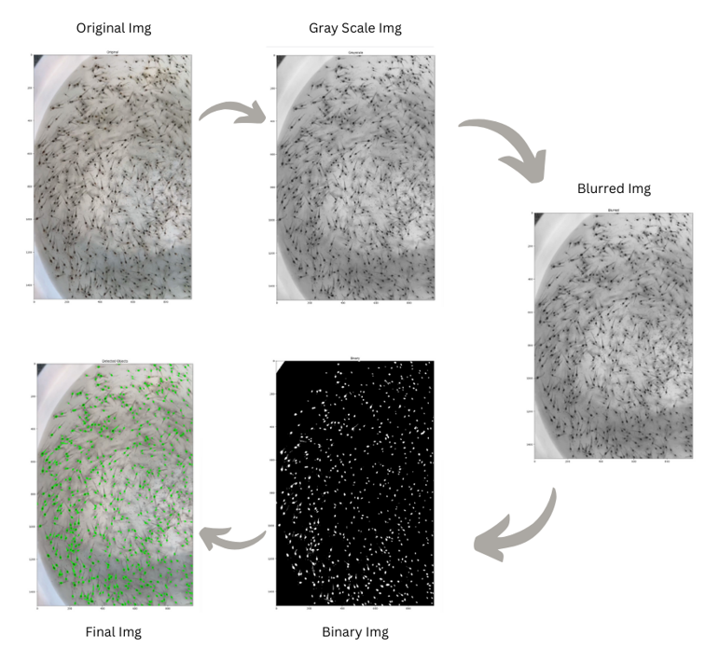
How the System Works
Input: Upload an image of PL seeds.
Preprocessing:
Convert to grayscale.
Apply Gaussian blur to reduce noise.
Thresholding:
Binary conversion isolates PL seeds from the background.
Detection:
Contours are identified, filtered by size, and counted.
Output: Display annotated results with total seed count.
Ref: https://github.com/TEEPAKRAAJ/Prawn-seed-detection

Slide 5
Why Our System Stands Out
Optimized for Post-Larva Seeds:
Tailored detection algorithms designed to handle small seed sizes.
High Precision:
Eliminates errors from manual counting.
Customizable Parameters:
Adjustable for different environmental conditions and image quality.
Time-Saving:
Processes images within seconds.

Slide 6
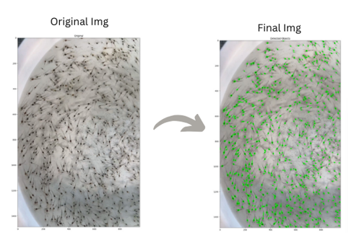
System in Action: Detection Results
Before and After Images:
Show the original image of PL seeds.
Display the processed result with seed count overlay
On average, our system detected 99% of PL seeds accurately in diverse lighting and background conditions..

Slide 7
Applications of the System
Hatcheries:
Quality control during seed packaging and distribution.
Aquaculture Farms:
Accurate stocking density calculation for ponds.
Seed Transport Monitoring:
Ensures seed survival and uniform distribution during transit
This system can save time and ensure consistent results across multiple batches of PL seeds."
"A valuable tool for hatcheries aiming to streamline operations and improve productivity..

Slide 8
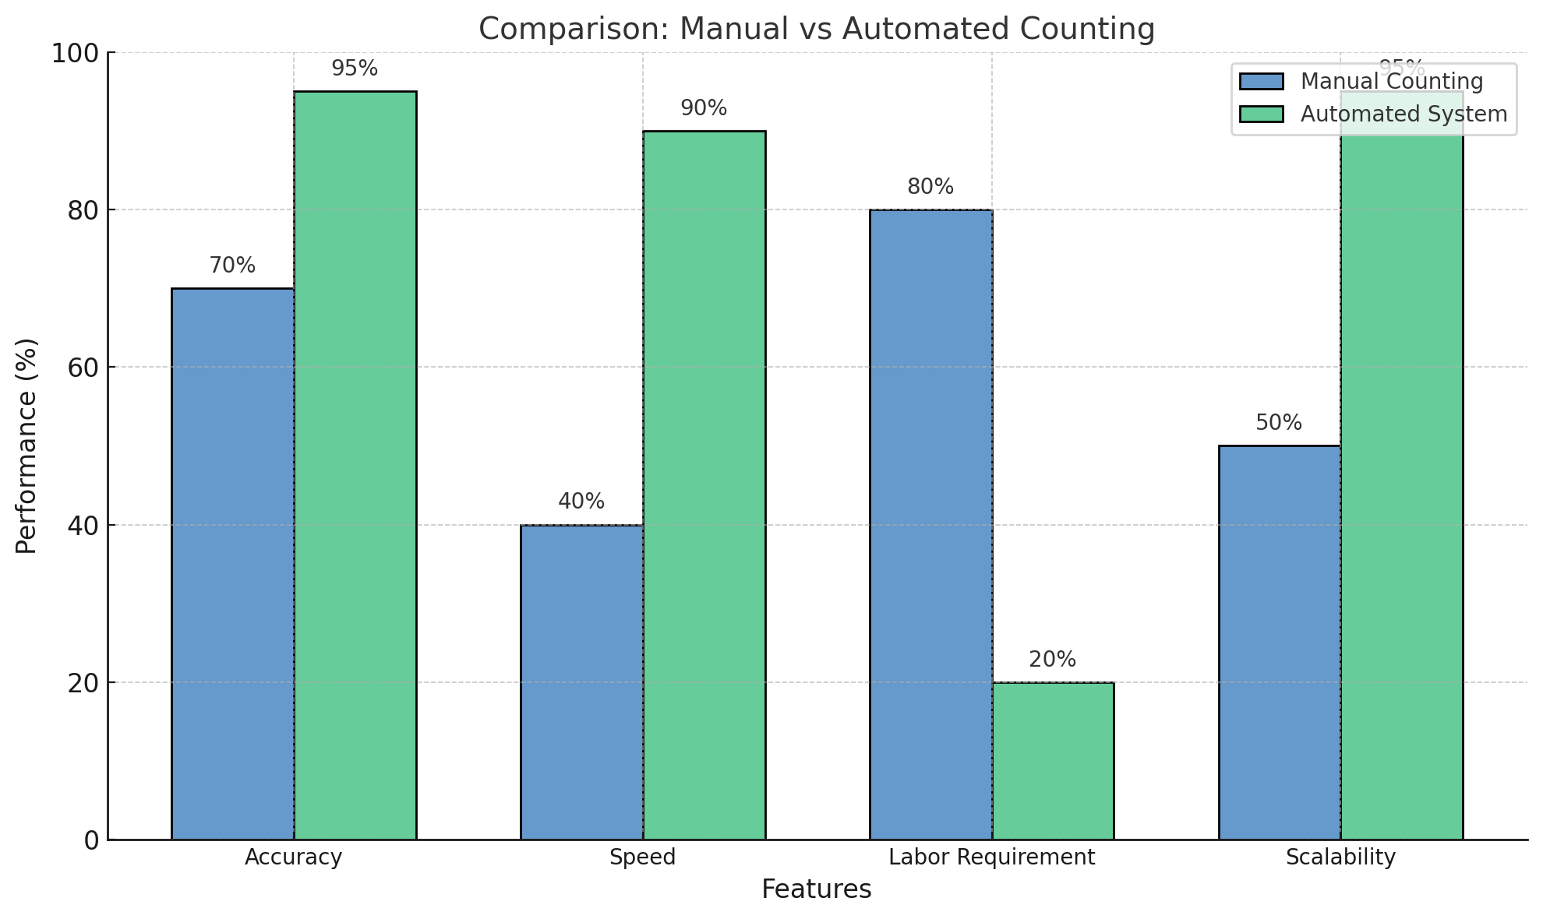
Why Automation is Superior
Feature | Manual Counting | Automated Dection
Accuracy | Variable | Consistent (>95%)
Speed | Slow | Fast (seconds/image)
Labor Requirement | High | Minimal
Scalability | Limited | Unlimited

Slide 9
Adaptable to Your Needs
Simple Setup Requirements:
A white tray serves as an ideal background for better contrast.
Proper lighting eliminates shadows and enhances detection accuracy.
Works Across Conditions:
Handles variations in seed size and density.
Adjustable detection settings for different image qualities.
Effortless Integration:
Seamlessly fits into existing workflows without significant changes to infrastructure.

Slide 10
Expanding Possibilities
Mobile App Integration:
Real-time detection on the go.
Video Stream Analysis:
Detect and count PL seeds directly from live footage.
AI Enhancements:
Machine learning to adapt to new environments automatically.

Slide 11
THANK YOU
Teepakraaj G (Intern)

